Slide 1
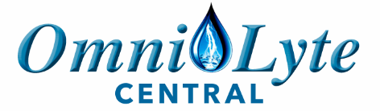

Sam Hofer: Sales & Marketing
Phone: 270-318-0677
Email: sam@OmniLyteUSA.com
Website: omnilytecentral.com

Slide 2
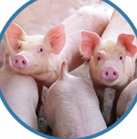
PIGS
Control and Reduction of Disease
Better Digestion and Feed Conversion Ratios
Increasing Livestock Yields
Water Purification for: PIGS

Slide 3

INCREASED PROFITIBILITY
INCREASED SAFETY
ELIMINATE ANTIBIOTIC USE
ELIMINATE TOXIC CHEMICAL USE

Slide 4
AN EXCELLENT SOLUTION
STERILIZATION • WATER PURIFICATION • DISINFECTION
We are committed to providing modern chemical free and antibiotic free solutions for Disinfection, Hygiene, Water Treatment, Commercial Alkaline Ionized Water with Innovative ecological technologies targeting the Pig farming market.

Slide 5
ENVIROMENTALLY FRIENDLY CLEAN WATER
Our Envirolyte system uses a state of the art patented Membrane Electrolysis Technology Envirolyte Generator that produces powerful disinfection agents on-site without risks to humans or animals, using just SALT, WATER & ELECTRICITY!
All Natural
Bio-Degradable
100% Totally-Green
Environmentally-Friendly
Non-Toxic
Organic
Electrically Activated Simply From Salt, Electricity, & Water

Slide 6
ANOLYTE
Anolyte is the most effective Non-Chemical disinfectant available and is used to address all types of bacteria, viruses, fungi, spores, and toxic microbial organisms.
Most significantly, micro-organisms cannot build a resistance against it!
Anolyte is up to 300 times more effective than bleach and can be used to replace your existing systems.
The active ingredient, Hypochlorous acid (HOCl), cannot be produced through conventional chemical reactions.

Slide 7
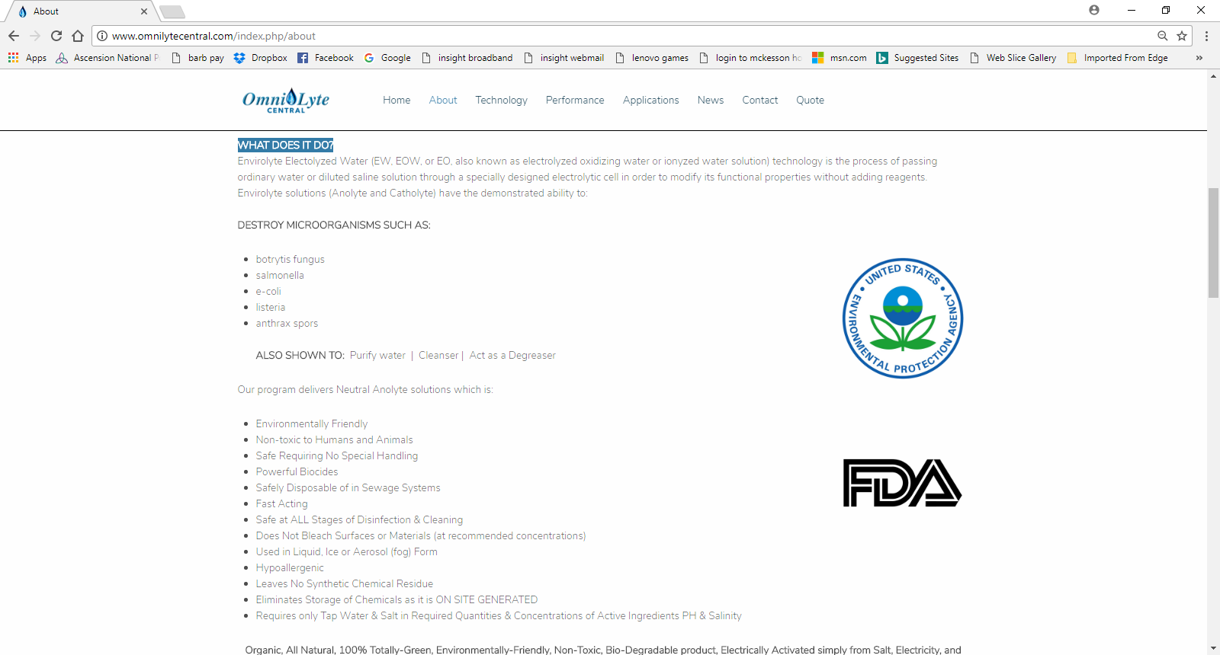

EPA, FDA, & USDA APPROVED
EPA, FDA, and USDA approved, we have found that the use of Envirolyte Electrolyzed Water ECA technology will convincingly improve the bottom line increasing Profitability, Serenity, Safety, & Less Antibiotics in each and every livestock application with rapid system payback, even if the customer testifies he has good water.

Slide 8
WHAT DOES IT DO?
Envirolyte Electolyzed Water (EW, EOW, or EO, also known as electrolyzed oxidizing water or ionized water solution) technology is the process of passing ordinary water or diluted saline solution through a specially designed electrolytic cell in order to modify its functional properties without adding reagents. Envirolyte solutions (Anolyte and Catholyte) have the demonstrated ability to:
DESTROY MICRO-OGRANISMS
PURIFY WATER
ACTS AS CLEANSER & DEGREASER

Slide 9
ORP – IS IT IMPORTANT? YES!
Oxidation-Reduction Potential = Measure of the cleanliness of the water & its ability to break down contaminants.
ORP sensors work by measuring the dissolved oxygen. More contaminants in the water results in less dissolved oxygen because the organic material consumes the oxygen, therefore, the lower the ORP level. The higher the ORP level, the more ability the water has to destroy foreign contaminants such as microbes, or carbon based contaminants.
ORP Level (mV) | Application
0 – 150 | No practical use
150 – 250 | Aquaculture
250 – 350 | Cooling Towers
400 – 475 | Swimming Pools
450 – 600 | Hot Tubs
600 | Water Disinfection
800 | Water Sterilization

Slide 10
ORP AND BACTERIAL ACTIVITY
ORP Level | Coliform count in 100 ml of water
200 | 300
300 | 36
400 | 3
600 | 0
There is a direct relationship between the ORP level and the Coliform count in water. An ORP meter measures the small voltages generated with a platinum or gold probe placed in ozonized water.

Slide 11
EQUIPMENT CAN PRODUCE
TWO BASIC TYPES OF FLUID
1.) Anolyte solutions are strong oxidizing solutions with:
  pH range of 2.5 to 8.5
  ORP (Oxidation-Reduction Potential) of +600 to +1200 mV
Uses include broad spectrum germicidal, disinfectant, purification
2.) Catholyte solutions are anti-oxidizing, mild alkaline solutions with:
  pH of 10.5 to 12.0
  ORP of -600 to -900 mV
Uses include cleanser/detergent, degreaser

Slide 12
BENEFITS OF ANOLYTE APPLICATION
MORTALITY RATE REDUCTION by 50-80%
MEDICINE COST REDUCTION 50-90%
BETTER FEED CONVERSION RATIO
MORE EFFECTIVE DIESEASE CONTROL & CURE
COMPLETE HYFIENE PROTOCOL WITHOUT CHEMCICALS
BETTER WEIGHT GAIN AT ALL CYCLES OF PIG GROWING

Slide 13
GROWTH & MARKET
The graph shows average daily gain reports for grower to finished pigs based off one whole year of data without the addition of Anolyte vs one whole year with the addition of Anolyte. As a result, client has significant more space in feeder barn with more throughput, and is in the process of increasing his sows herd from 550 to 700 sows we can confidently say. That client has a magnificent 43% increase in average daily gain resulting in many $$$.
Also the graph shows average days to market reports for grower to finished pigs based off 5 months of data from Jan. to May with out Anolyte in 2015, and with Anolyte 2016. Nothing has changed in this operation besides the addition of Anolyte. This is HUGE for your bottom line.

Slide 14
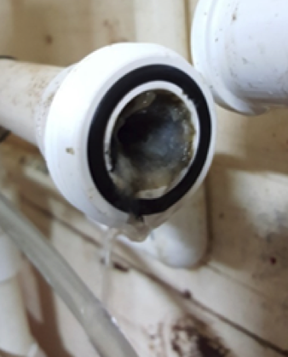
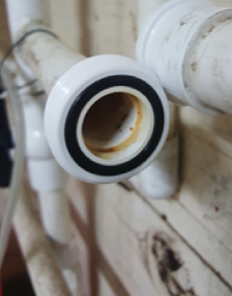
ANOYLYTE DOSING
THE EXCESSIVE BIOFILM IS A
RESULT OF INEFFICIENT DISINFECTION
NO ADDITIONAL LINE CLEANING CHEMICALS WERE USED
BEFORE
ANOYLYTE DOSING
AFTER
ANOYLYTE DOSING

Slide 15
CHLORINATION VS. ANOLYTE
Anolyte is safer and more effective in eradicating hazardous conditions such as Legionella
 | CHLORINATION | ANOLYTE
Solution | Sodium Hypochlorite Solution | Hypochlorous Acid Solution
Compound Description | NAOCL | HOCL
Other Name | Bleach | Anolyte
Usage level | 50 ppm | 0.25 to 5 ppm (even at 500ppm it is Not harmful to people or animals)
MSDS Statements | Very hazardous in case of skin contact, eye contact, ingestion. It is an irritant and corrosive. Prolonged exposure may result in skin burns and ulcerations | Under normal use conditions the likelihood of any adverse health effects are low. The solution is recommended for treatment of infected or purulent wounds. If any irritation occurs, flush with water.
Dose level harmful to people | Yes | No
Kills Legionella | Yes | Yes
Removes Biofilm and Scale, eliminating hidden legionella and other bacteria | No | Yes
At high pH | Hypochlorite Ion (OCl-) | Hypochlorous Acid (HOCl)
Contact time |  | Requires the shorted time to achieve a 99% kill of E. coli
Shelf-life | Lye added resulting in burn potential | No Lye added
Biocidal impact | Only as disinfectant | As Disinfectant and sporicidal agent
Resistance | Bacteria develops resistance to bleach due to its method of attack and residual organisms, biofilm remaining, and interaction with detergents | Bacteria does not develop a the same type of resistance due to impact at cellular level, destroys biofilm, and no need for significant detergent use.

Slide 16
CHLORINATION VS. ANOLYTE
Anolyte is safer and more effective in eradicating hazardous conditions such as Legionella
Disinfectant | Description | Advantages | Limitation
Anolyte | Electrochemical activation of brine solution in a membrane electrolyser | Strong disinfect and and oxidation agent Very effective against all kinds of bacteria and viruses Highly effective as sporicidal agent Effectively eliminates bad tastes and odors Removes biofilms Significantly less formation of chlorine compounds, halogens and TMT No toxic by products: chlorites (ClO2) and chlorates (ClO3) No acute or chronic toxicity when diluted in water Low cost No transport or storage problem Easy and safe storage and handling | Ventilation might be required in the installation room to remove fumes
Chlorine | Used in a gaseous state, requires strictest safety measures | Efficient oxidant and disinfectant Efficiently eliminates tastes and odors Featured with aftereffect Capable of controlling the growth of algae, biological slimes and microorganisms Decomposes organic contaminants (phenols…) Iron and magnesium oxidant. Decomposes hydrogen sulfide, cyanides, ammonium and other nitrogen compounds | Strict requirements for transportation and storage Potential danger for health in case of a leak. Formation of disinfection byproducts, such as chloroform. The MAC in water will be increased in the near future from 60 mkg/l up to 60 mg/l because there was no proof of direct action of the chloroform on DNA.

Slide 17
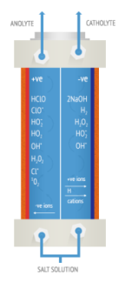
WHAT IS ANOLYTE
Anolyte Water, a mixed oxidant, is produced by electrolyzing dilute brine(NACL) water in the cathode & anode chamber of an unique diaphragmatic electrolytic cell. An electro-chemical activation is used to convert an aqueous solution of sodium chloride into a solution known as “Anolyte.”

Slide 18
ANOLYTE IS SUPERIOR
Only Anolyte can claim to be Effective as a Disinfectant and Safe, Removes Biofilm, Eliminates Algae, is Easy to Maintain, and has a Low Cost throughout its Lifecycle.
Anolyte is Superior to sodium hypochlorite in destroying spores, bacteria, viruses and other pathogens.
For more than 10 years, Anolyte has demonstrated that microorganisms do not develop a resistance against the disinfection power of Anolyte over any period of time
  Pathogens develop a resistance to sodium hypochlorite over time
  Sodium hypochlorite at 5% concentrate disinfects; however, it does NOT sterilize and is NOT effective against cysts (Guardia, Cryptosporidium)

Slide 19
ANOLYTE IS SUPERIOR
Anolyte has a lower kill time
  - Sodium hypochlorite loses its strength during long-term storage and is a potential danger due to the production of gaseous chlorine emissions during storage period
Anolyte is more soluble
Anolyte is effective as a bactericidal at pH values of 4-9
Anolyte can be produced at an ORP up to +1200 making it more effective as a biocide (+800 is pure sterilization)
Anolyte is minimally corrosive – Anolyte is the Product of choice for disinfection
Anolyte produces about half the trihalomethanes when interacting with organic material in comparison to traditional chlorine use.
Anolyte is anti-scaling:
  - Eliminates existing scale
  - Eliminates pathogens being harbored within scale
  - Blocks any dissolved solids within the water supply, so new scale is prevented
  from forming.

Slide 20
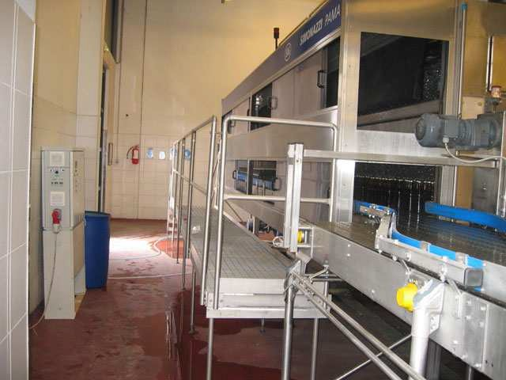
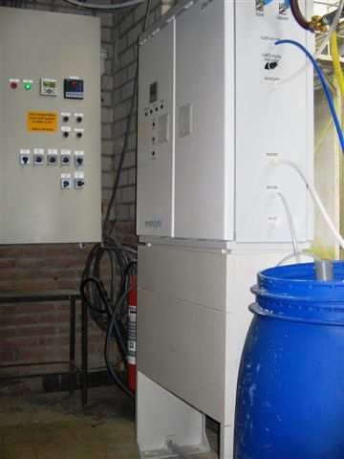
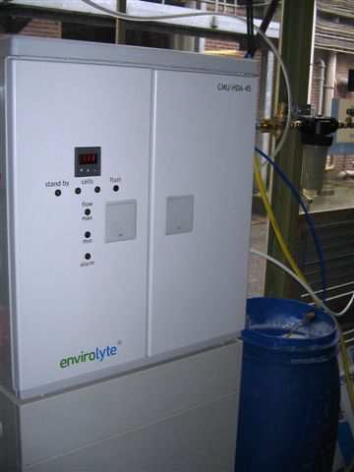
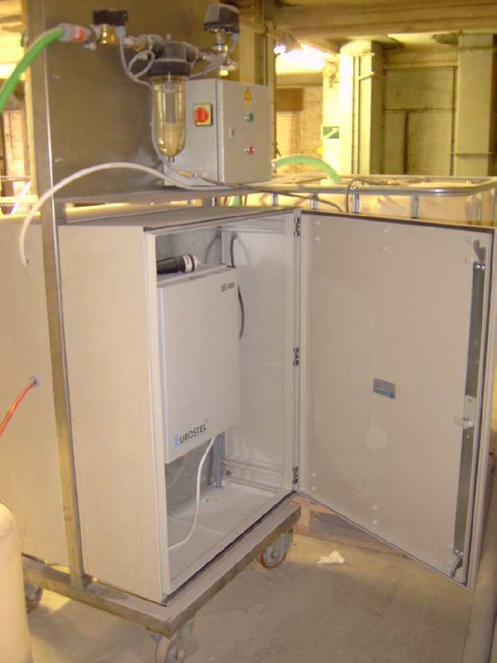
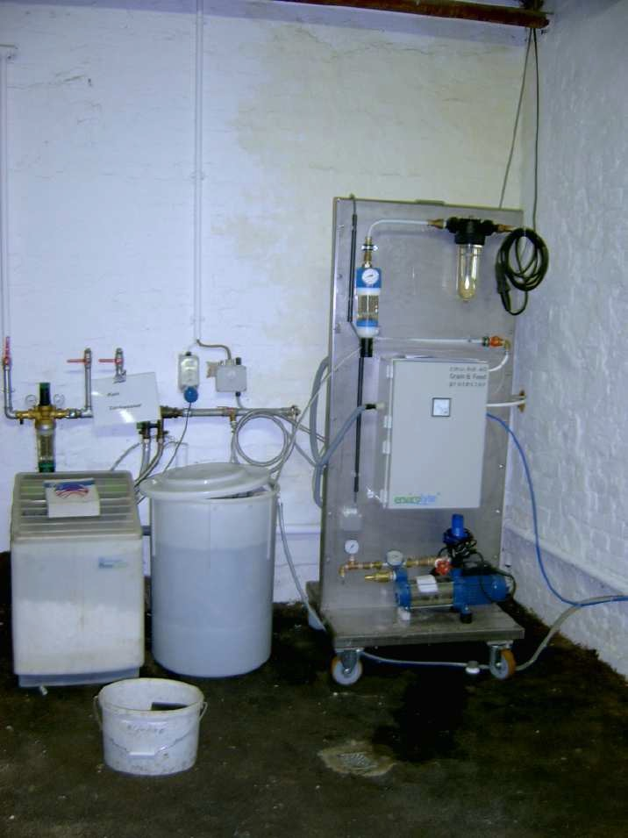
CUSTOM ENVIROLYTE INSTALLS

Slide 21
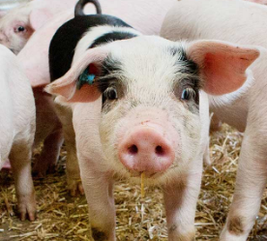
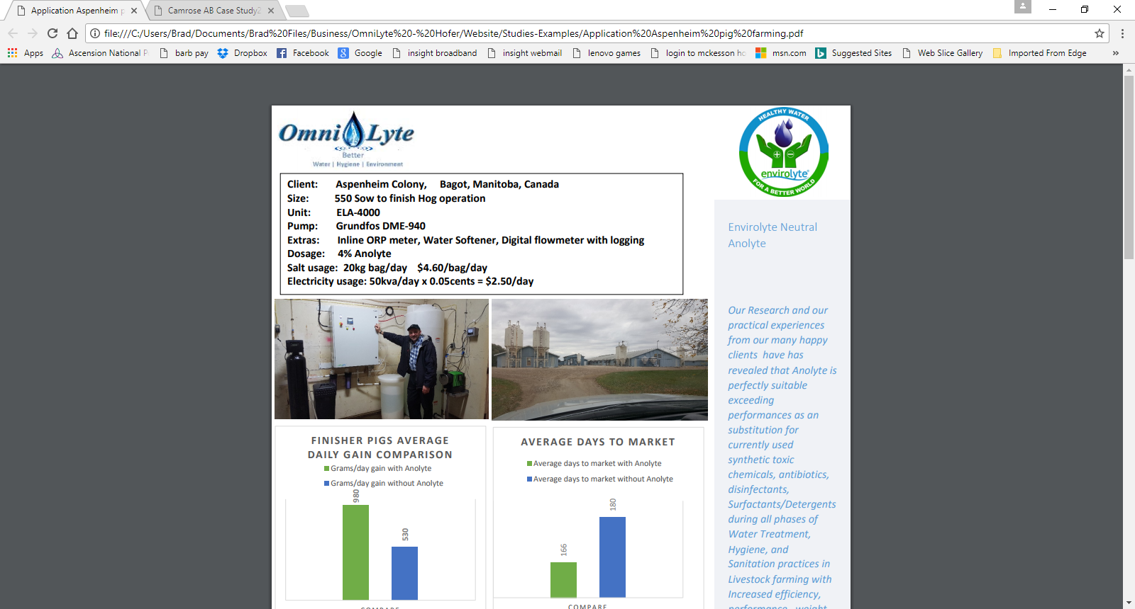
ASPENHEIM FARMS
Client: Aspenheim Farms, Bagot, Manitoba, Canada
Size: 500 Sow to finish Hog operation
Unit: ELA –4000 Pump: Grundfos DME-940
Extras: Inline ORP meter, Water Softener, Digital flowmeter with logging
Dosage: 4% Anolyte
Salt usage: 20kg bag/day $4.60/bag/day
Electricity usage: 50kva/day x 0.05 cents = $2.50/day

Slide 22
ASPENHEIM FARMS ANOLYTE BENEFITS
Promotion of general health as a drinking water additive
Super effective disinfectant, waterline cleaner, and biofilm/scale remover
Statistically proven better mortality, digestion, weight gain & feed conversion
Disease control, and cure • Rapid Return on Investment
Grain and feed storage additive (reduced mold)
Bacteria control through misting or fogging (Pest Control on the skin)
Results: One month after dosing Anolyte, we noticed all lines were completely free from biofilm and debris. Pigs looked healthier with more Energy.
Conclusion: The addition of Anolyte for this application has exceeded all expectations and performances with the Client testifying that the Anolyte System was paid off in less than four months. Not hard to believe, and we have seen this many times before. This Client had good quality well water to begin with but lacked the very important ingredient that every water distribution needs: “Safe, Powerful, and Non-Toxic, Disinfection and Water Purification”

Slide 23
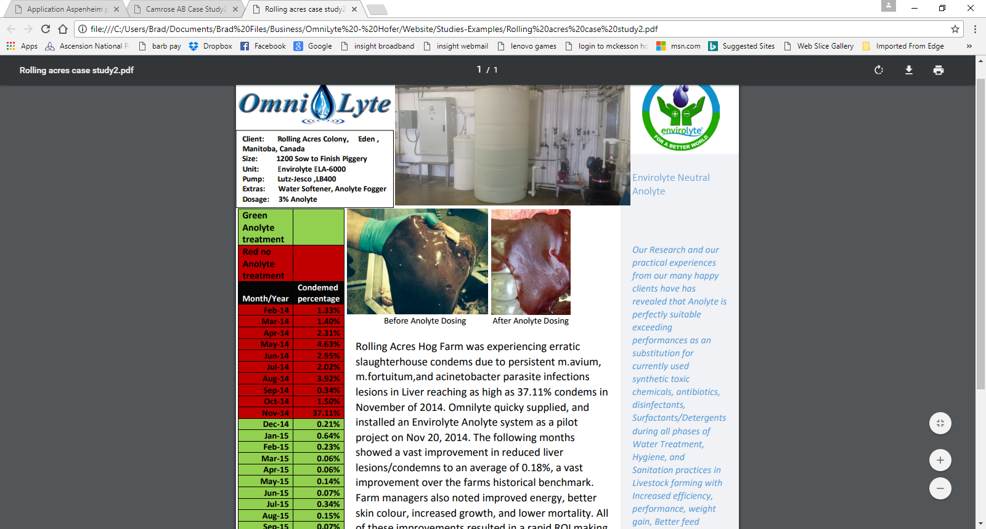
ROLLING ACRES FARM
Before Anolyte Dosing
After Anolyte Dosing
Client: Rolling Acres Farms, Eden , Manitoba, Canada
Size: 1200 Sow to Finish Piggery
Unit: Envirolyte ELA-6000
Pump: Lutz-Jesco ,LB400
Extras: Water Softener, Anolyte Fogger
Dosage: 3% Anolyte

Slide 24
ROLLING ACRES FARM
Rolling Acres Hog Farm was experiencing erratic slaughterhouse condemns due to persistent m.avium, m.fortuitum,and acinetobacter parasite infections lesions in Liver reaching as high as 37.11% condemns in November of 2014.
OmniLyte quickly supplied, and installed an Envirolyte Anolyte system as a pilot project on Nov 20, 2014. The following months showed a vast improvement in reduced liver lesions/condemns to an average of 0.18%, a vast improvement over the farm’s historical benchmark. Farm managers also noted improved energy, better skin color, increased growth, and lower mortality. All of these improvements resulted in a rapid ROI making this there best investment to date!
Envirolyte ELA-4000 Electrolyzer dosing Anolyte at 4% for 550 Sow Operation.
1. 43% increase in daily gain!
2. Gained 14 days to market for his feeder pigs!
3. Feed conversion improved by 30%
4. Significant improvement in mortality
5. Pigs feeling better and more active

Slide 25
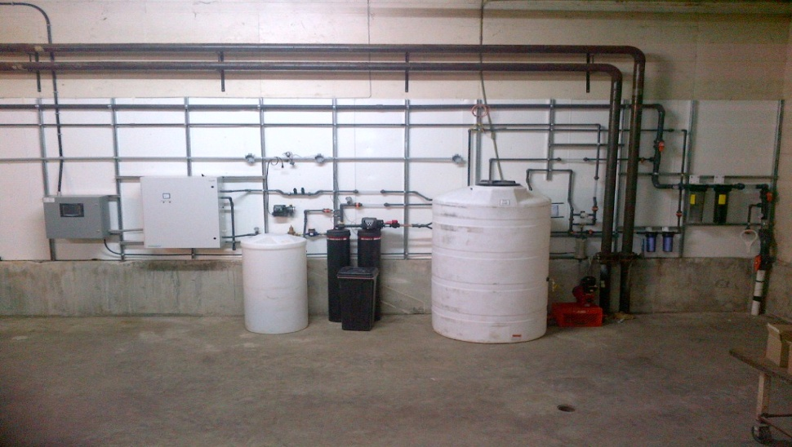
HURON FARMS, ELIE, MB, CANADA
Envirolyte EL-6000 Electrolyzer dosing their RO Water with Anolyte at 2% for 680 Sow Farrow to Finish operation.
"Ever since we started using Anolyte we have had many good results. After years of E-Coli in the farrowing it has disappeared over 97%. Had skin diseases in some pigs (Greasy Pig) where there was no cure, and so far Anolyte showed 100% effective in curing it. Had potent Bio-film in water lines that carried E.coli--now are totally spotless/clean in only month of using Anolyte. Before Anolyte, we tried CID-2000 and other products with too much money spent and wasted with little results. It has even reduced our medication and disinfectant expenses. Awesome product and safe to use”

Slide 26
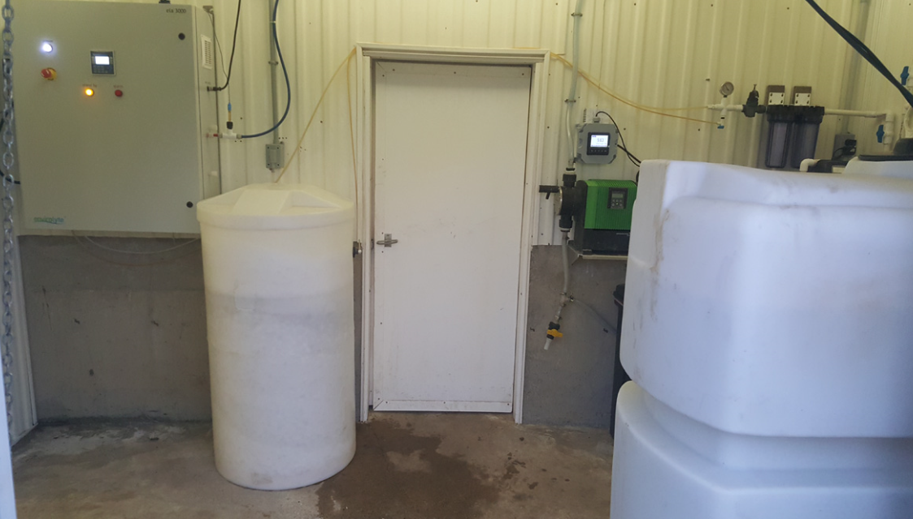
CAMROSE FARMS, CAMROSE, AB, CANADA
Camrose Farms installed the Ela-3000 for their 500 Sow to Weanling Hog operation and stated: “Better than peroxide, and acid any day plus saving 50G/year’’

Slide 27
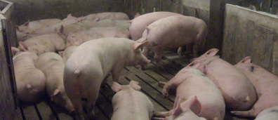
MAYFAIR FARMS, KILLARNEY, MB, CANADA
The Mayfair Farms installed the ELA-4000 Electrolyzer for their 1200 Sow Top pigs Multiplier operation and reported: Before we used Anolyte we were shipping pigs at 210 days average 130 kg. We started injecting Anolyte and saw a fast response in growth. We are now shipping our first hogs out of rooms 162 days old and still maintaining a 130 kg average. We now have all the pigs gone the oldest with 185 days as well as O.5 % in mortality drop.

Slide 28
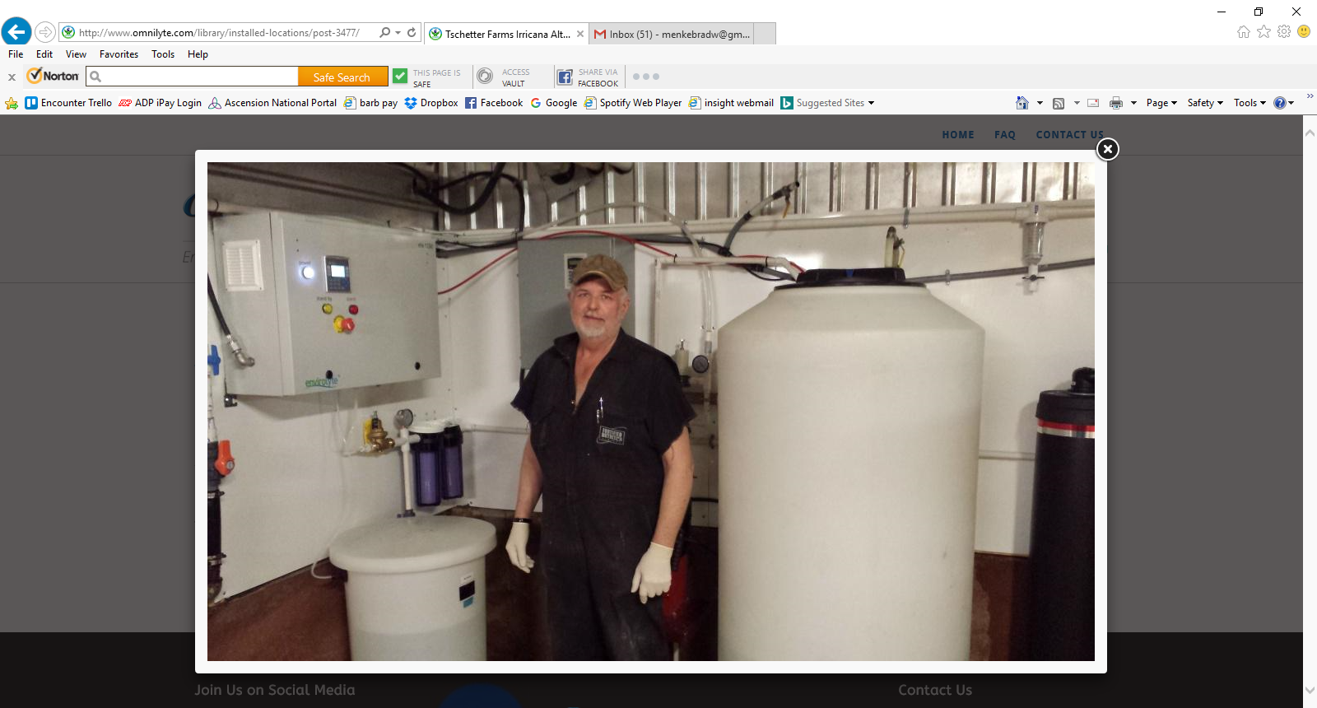
TSCHETTER FARMS, IRRICANA, ALTA., CANADA
Tschetter Farms installed the ELA-1200 Electrolyzer, dosing livestock water with Anolyte at 4% for their 240 Sow farrow to finish operation. They reported obvious gained benefits after only a week of dosing with:
Aggressive cleaning of water lines with more water pressure,
Better feed conversion/weight gain, and
Improvement in Animal Health.

Slide 29
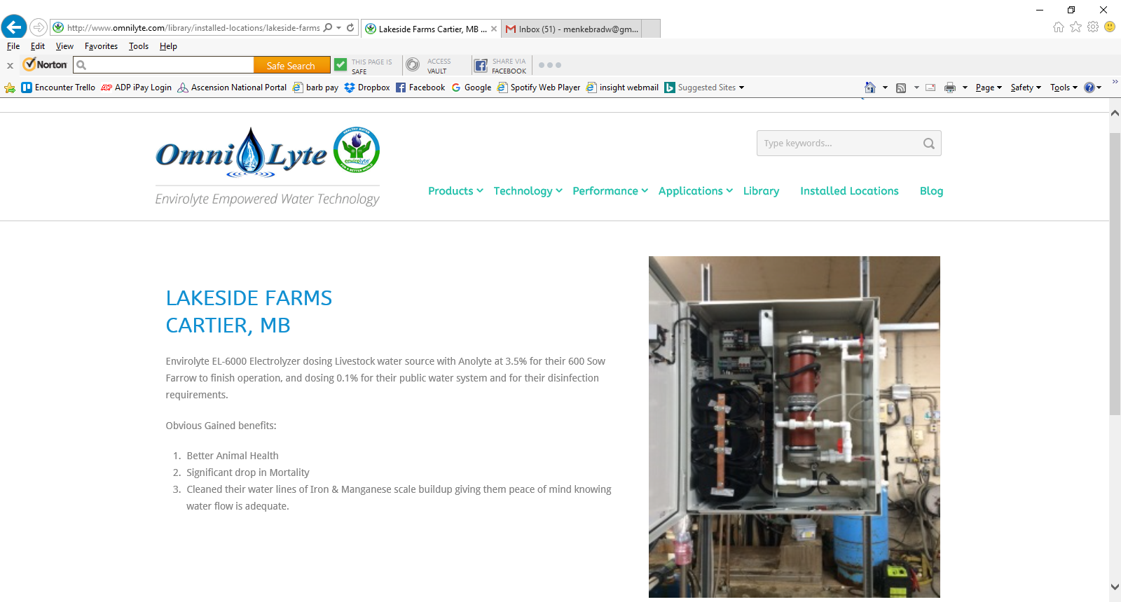
LAKESIDE FARMS, CARTIER, MB, CANADA
Lakeside Farms installed the EL-6000 Electrolyzer, dosing livestock water source with Anolyte at 3.5% for their 600 Sow Farrow to finish operation.
Obvious Gained benefits:
Better Animal Health
Significant drop in Mortality
Cleaned their water lines of Iron & Manganese scale buildup giving them peace of mind knowing water flow is adequate.

Slide 30
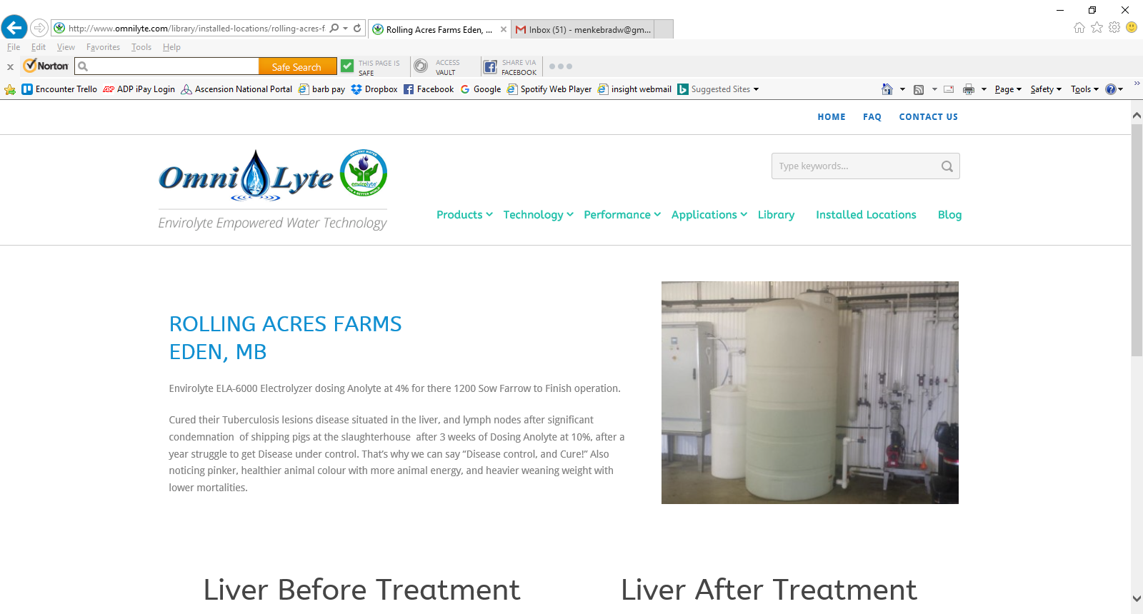
ROLLING ACRES FARMS, EDEN, MB, CANADA
Rolling Acres Farms installed the ELA-6000 Electrolyzer, dosing Anolyte at 4% for their 1200 Sow Farrow to Finish operation. They reported that it cured their Tuberculosis lesions disease of the liver and lymph nodes. after significant condemnation of shipping pigs to the slaughterhouse after 3 weeks of Dosing Anolyte at 10%, following a year long struggle to get the disease under control. They also reported noticing pinker, healthier animal color, increased animal energy, heavier weaning weight, and lower mortality rates.

Slide 31
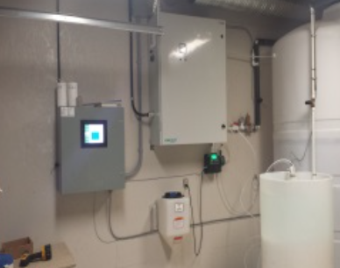
RIDGELAND FARMS, DUGALD, MB, CANADA
Ridgeland Farms installed the EL-6000 Electrolyzer, dosing their water with Anolyte at 3% for 630 Sow Farrow to Finish operation.
They reported: “Decreased mortality, improved conception, and significantly reduced scours in Farrowing”

Slide 32
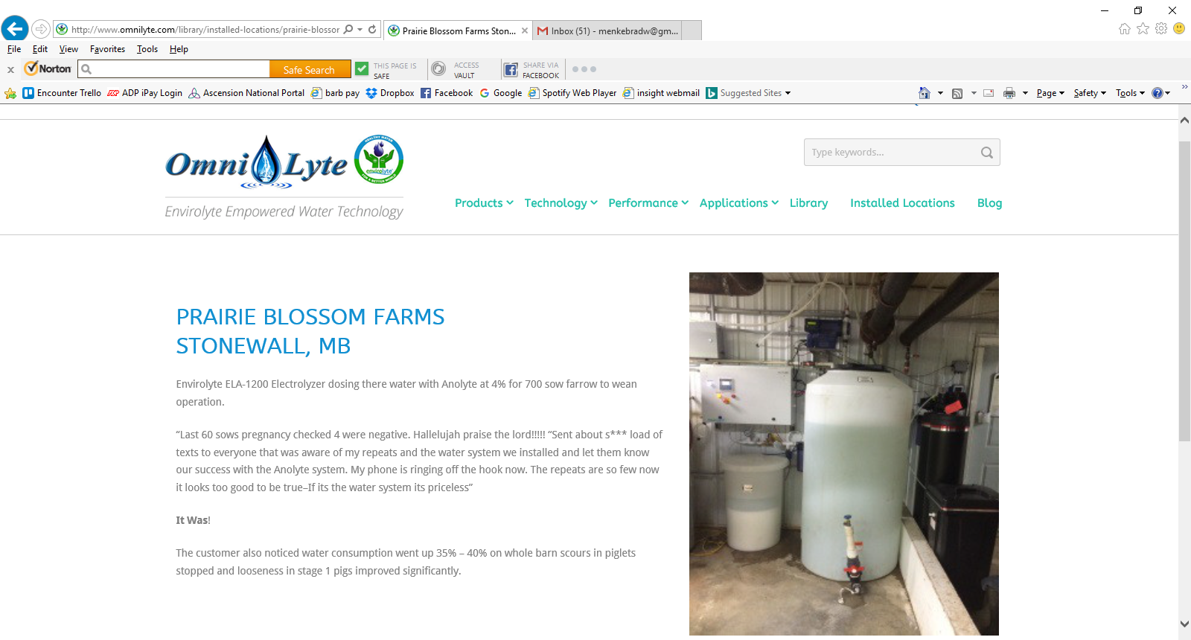
PRAIRIE BLOSSOM FARMS, STONEWALL, MB, CANADA
Prairie Blossom Farms installed the ELA-1200 Electrolyzer, dosing there water with Anolyte at 4% for 700 sow farrow to wean operation.
They reported: “Last 60 sows pregnancy checked 4 were negative. Hallelujah Praise the Lord!!!!!” Sent ”texts to everyone that was aware of my repeats and the water system we installed and let them know our success with the Anolyte system. My phone is ringing off the hook now. The repeats are so few now it looks too good to be true–If it’s the water system it’s priceless”
It Was!
The customer also noticed water consumption went up 35% – 40%.
Barn scours in piglets stopped and looseness in stage 1 pigs improved significantly.

Slide 33
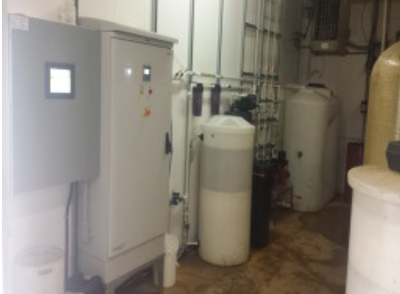
BONHOMME FARMS, ELIE, MB CANADA
Bonhomme Farms installed the ELA-6000 Electrolyzer, dosing Anolyte at 4% for 680 Sow farrow to finish operation. They also began dosing 7000 layers at 2%. They reported noticing aggressive waterline cleaning, and maintenance with piglet scours reduced to none. Excellent sow lactating, and feed intake with lower mortality, and faster weight gain.

Slide 34
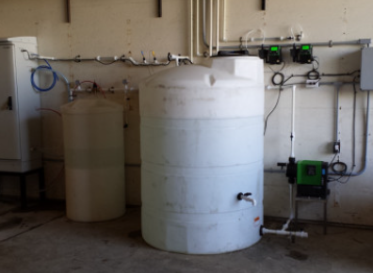
NORQUAY FARMS, CANADA
A week after Dosing Anolyte 850 Sow Farrow to finish operation at 4% Neutral Anolyte, Narquay Farms noticed:
1. Sows fecal matter more loose, and clarity
2. Powerful line cleaning action.
3. Don’t need more expensive pit additive or flowing agents
4. Sows have a heartier appetite and are eating better

Slide 35
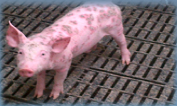
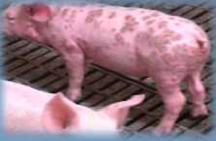
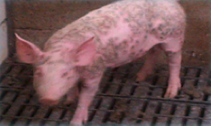
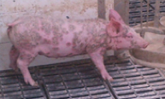
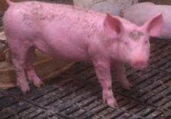
RESULTS
SKIN DISEASE
BEGINNING
SKIN DISEASE
GETTING WORSE
ONE WEEK OF ANOLYTE DIPPING
DISEASE FREE!!

Slide 36
NEXT STEPS
Call OmniLyte Central
  (270) 318-0677
  Ask For Sam
Request Anolyte to Try
Get a Quote on a complete system
Replace Existing System
  Eliminate Antibiotics
  Reduce Operating Expenses
  Improve Animal Health
  Increase Profitability

Slide 37
Sam Hofer: Sales & Marketing
Phone: 270-318-0677
Email: sam@OmniLyteUSA.com
Website: omnilytecentral.com

